Slide 1
Evolutionary games and spatial chaos
Martin A. Nowak & Robert M. May

Slide 2
Abstract
Much attention has been given to the Prisoners’ Dilemma as a metaphor for the problems surrounding the evolution of cooperative behaviour.
This work has dealt with the relative merits of various strategies when players who recognize each other meet repeatedly, and more recently with ensembles of strategies and with the effects of occasional errors.
There are potential implications for the dynamics of a wide variety of spatially extended systems in physics and biology.

Slide 3
Game Theory
Strategy games
Prisoner’s Dilemma

Slide 4
Game Theory
Strategy games
Prisoner’s Dilemma
Non-Zerosum game ≡ sum of pay-off (cooperator and defector) ≠ 0

Slide 5
How to play this game
Player 1
Not interactive
Player 2

Slide 6
How to play this game
There are no information between Player 1 and Player 2 for each other
They can’t know their determined role for each other in the game playing by time step.
Player 1
Not interactive
Player 2

Slide 7
How to play this game
Cooperator
Player 1
Defector
Not interactive
Cooperator
Player 2
Defector

Slide 8
How to play this game
Cooperator
Player 1
Defector
Not interactive
Cooperator
Player 2
Defector
Initial condition

Slide 9
How to play this game
Cooperator
Cooperator
Defector
Player 1
Cooperator
Defector
Defector
Not interactive
Cooperator
Cooperator
Player 2
Defector
Defector
Cooperator
Initial condition
Defector

Slide 10
How to play this game
Cooperator
Cooperator
Defector
Player 1
Cooperator
Defector
Defector
Not interactive
Cooperator
Cooperator
Player 2
Defector
Defector
Cooperator
Initial condition
Defector
Determined (One round)

Slide 11
ASSUMPTIONS ( T>R>P>S )
Player 1
Cooperator
R
Player 1 or Player 2
Cooperator
S
Player 2
Pay-off
Pay-off
Player 1
Defector
P
Player 1 or Player 2
Defector
T
Player 2
Pay-off
Pay-off

Slide 12
Pay – off Inequality
T > R > P > S
Relatively chose the Defector
Both chose the Cooperator
Both chose the Defector
Relatively chose the Cooperator
Initial Condition : R=1, T=b (b>1), S=P=0

Slide 13

On $n×n$ lattice ($n=20 or more$)
Will be occupied by the player have the highest pay-off in this round.
neighbor
neighbor
neighbor
neighbor
Player
neighbor
Playing Games
(one time-step)
neighbor
neighbor
neighbor
Given initial conditions :
Cooperator or Defector

Slide 14
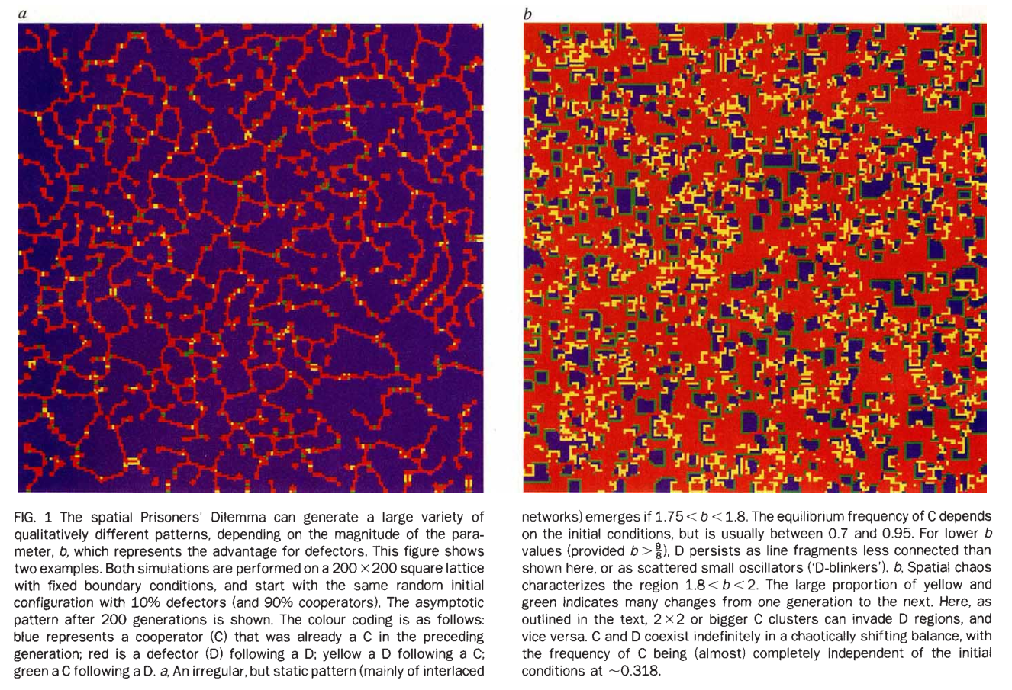
In the case of 1.75 < b < 1.8
In the case of 1.8 < b < 2

Slide 15
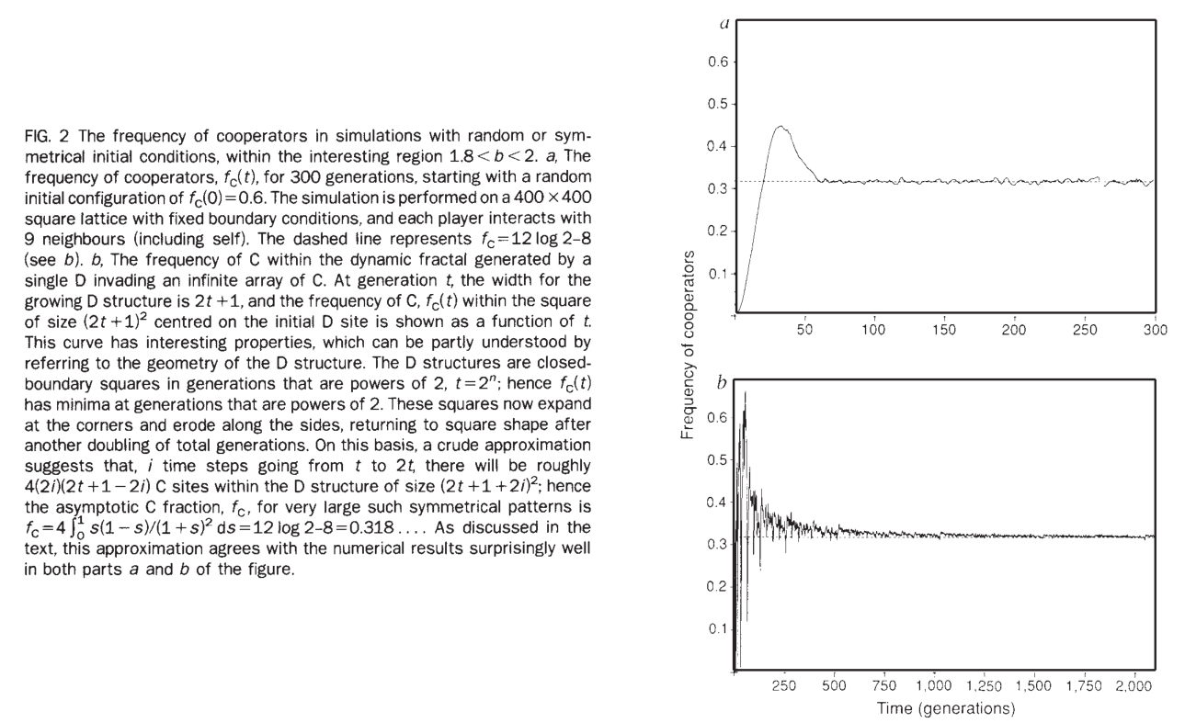

Slide 16
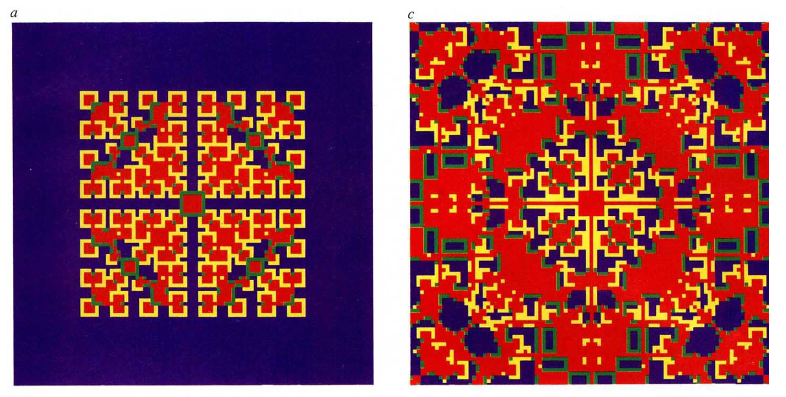


Slide 17
